Slide 1
Capstone Project 3 Mobile Price Range Prediction Supervised Machine Learning( Classification) by Rutuja Ahire e rice Range Prediction Supervised Machine Learning(Classification) by Team Data Avengers Rahul Chavan

Slide 2
Contents
1)Problem Statement
2)Data Description
3) Data Wrangling
4) Exploratory Data Analysis (EDA)
Univariate Analysis
Bivariate and Multivariate Analysis
5)Model Selection Evaluation
6)Evaluation of Models
7) Features Importance
8)AUC ROC Curves
9)Conclusion

Slide 3
Problem Statement
1)Mobile phones have become a necessity for every individual nowadays. People want more functions and best specifications in a phone and that to a cheaper prices.
2) Mobile phones come in all sort of prices, features, specifications and all. Price estimation and prediction is an important part of consumer strategy. Deciding on the correct price of the product is very important for market success of a product.
3)In the mobile phone market, companies want to understand sales data of mobile phones and factors which drive the prices. The objective is too find out some relation between features of mobile phones(eg:- RAM, internal memory, etc) and its selling price. In this problem, we don’t have to predict the actual price but a price range indicating how low price is.
4)The main objective of this project is too build a model which will classify the price range of mobile phones based on specifications of mobile phones.

Slide 4
Data Description
Total Rows= 2000
Total Features= 21
Total energy a battery can store in one time measured in mAh
Blue - Has bluetooth or not
Clock_speed - speed at which microprocessor executes instructions
Dual_sim - Has dual sim support or not
Fc - Front Camera mega pixels
Four_g - Has 4G or not
Int_memory - Internal Memory in Gigabytes
M_dep - Mobile Depth in cm
Mobile_wt - Weight of mobile phone
N_cores - Number of cores of processor
Pc - Primary Camera mega pixels

Slide 5
Px_height - Pixel Resolution Height Px_width - Pixel Resolution Width Ram - Random Access Memory in Mega Bytes Sc_h - Screen Height of mobile in cm Sc_w - Screen Width of mobile in cm Talk_time - longest time that a single battery charge will last when you are Three_g - Has 3G or not Touch_screen - Has touch screen or not Wifi - Has wifi or not Price_range - This is the target variable with value of 0(low cost), 1(medium cost), 2(high cost) and 3(very high cost).

Slide 6
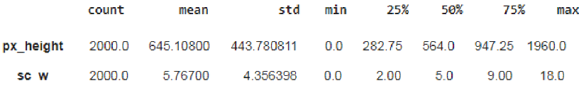
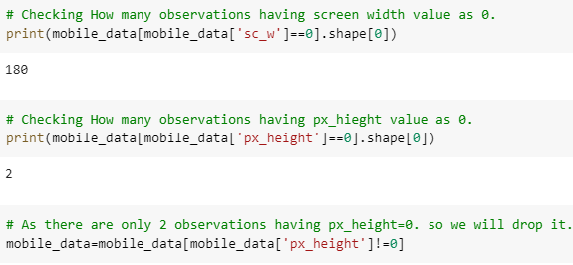
Data Wrangling
Handling Mismatch values in data
Missing values are imputed
using the K-Nernest neighbors
approach where a Eucliden
distance is used to find the
nearest neighbors.

Slide 7
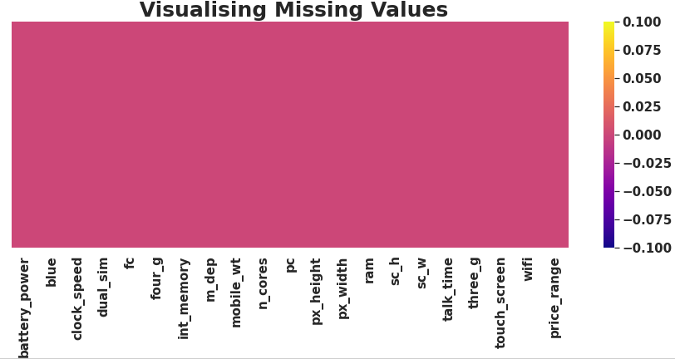

Data Wrangling
1)Zero missing value after handling
mismatch from the data.
2) 0 duplicates.

Slide 8
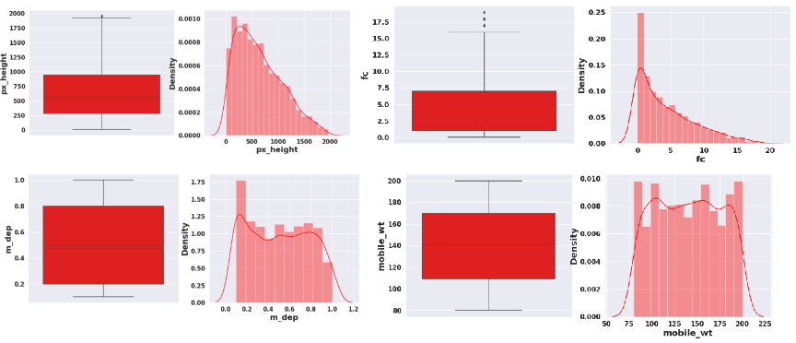
Data Wrangling
Checking outliers and Distribution of numerical variables.

Slide 9
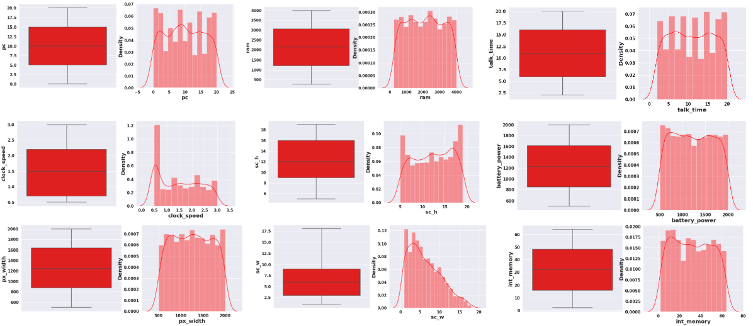

Slide 10
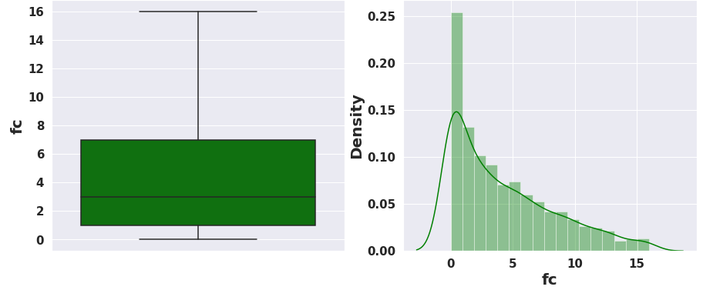
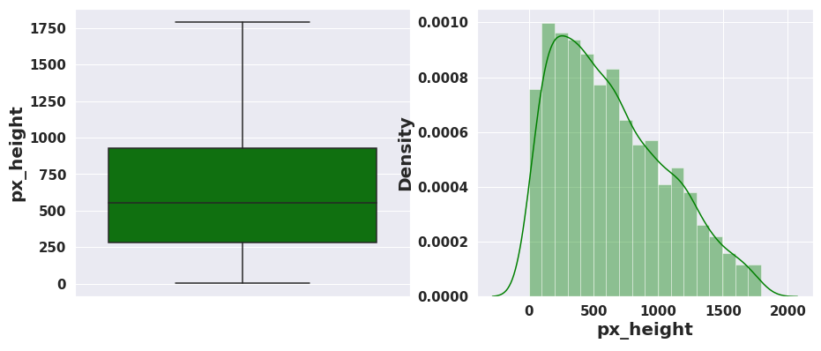
Data Wrangling
O After removal of outliers

Slide 11
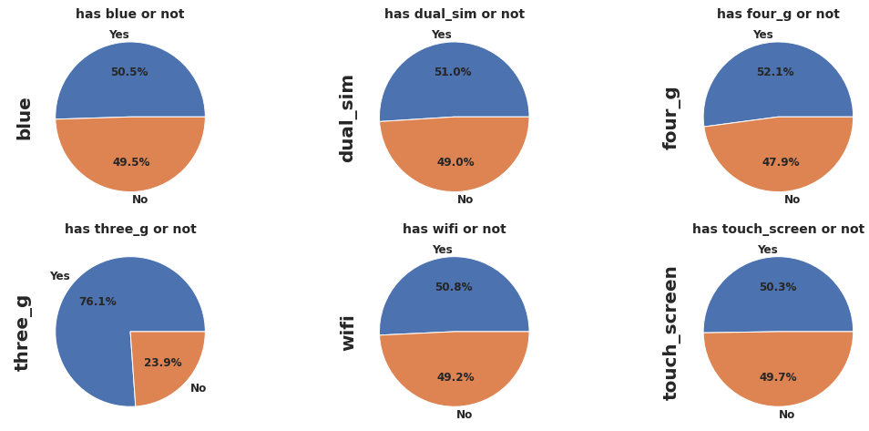
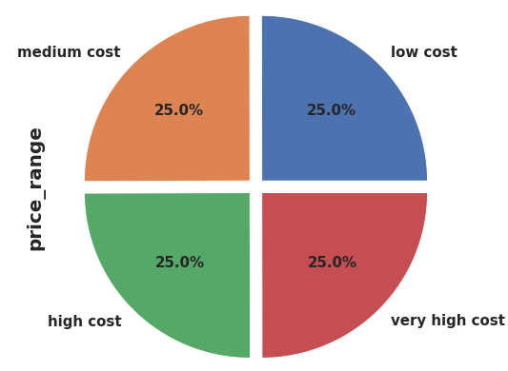
EDA or Exploratory Data Analysis
Univariate Analysis

Slide 12
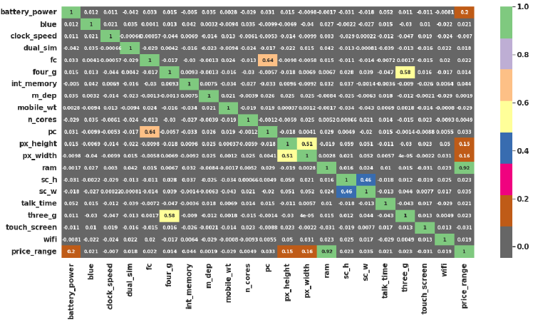
Bivariate and Multivariate Analysis
Correlation of independent
value with target Variable:
1)RAM has a strong positive
correlation with the Price
Range and we know that
Mobiles with a high RAM are
very costly. Thus RAM value
increase price range will Increase.
2) Primary camera i.e. is pc and
front camera fc are positively
correlated.

Slide 13
3) sc_h and sc_w are positively correlated. 4)Battery power also has a positive correlation with the price range. Generally mobiles having high prices comes with good battery power. 5)Also px_height and px_weight (Pixel resolution of height and width) are positively correlated. Generally high price range mobiles have a good resolutions. 6)Four_g and three_g are highly positively correlated. Nowadays most of the smart mobiles has both type of options. This could be the reason they are correlated.

Slide 14
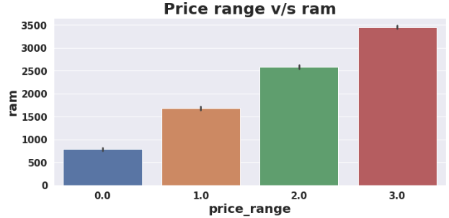
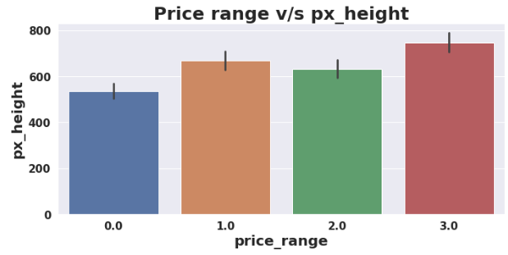
1] Mobiles have RAM more than 3000MB falls under very high cost category. As RAM increase price range also increase. 2] Mobiles having RAM less than 100MB falls under low cost category.

Slide 15
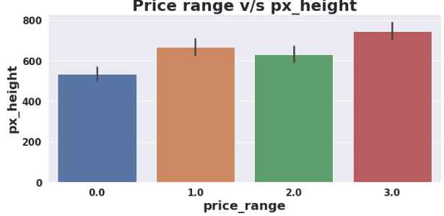
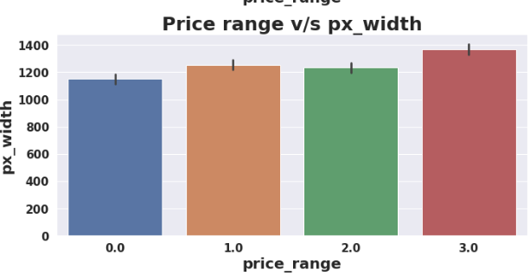
1] Mobile with battery power more than 1300mAh has very high cost. Mobiles with battery power between 1200 and 1300mAh falls under medium and high cost category. 2] Mobiles with more than 700 pixel height and width more than 1300 has a very high cost.

Slide 16
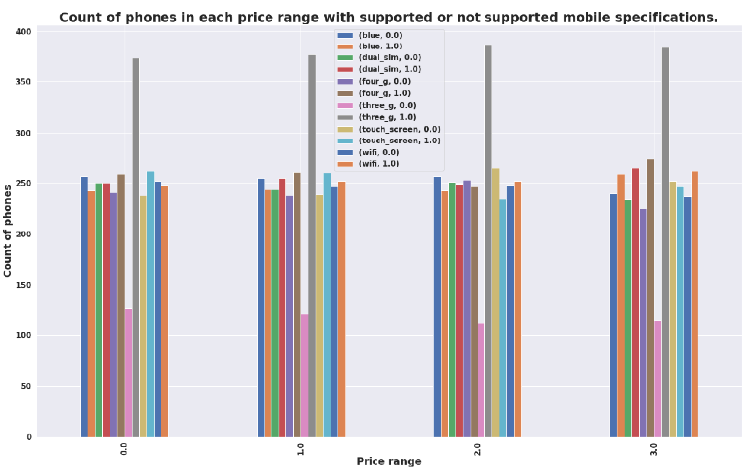
Bivariate and Multivariate Analysis
Each price range category has equal number of mobile phones both supporting and non supporting specifications.

Slide 17
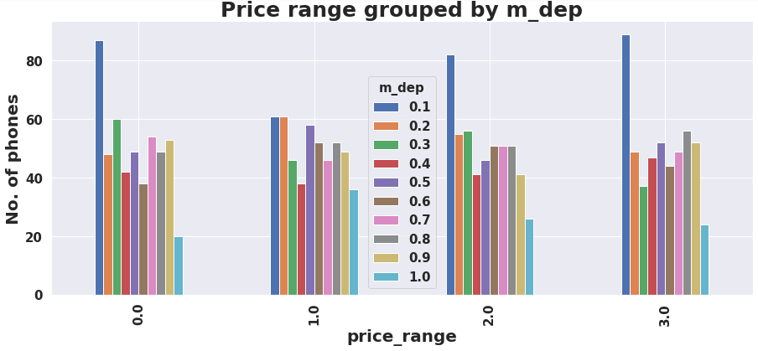
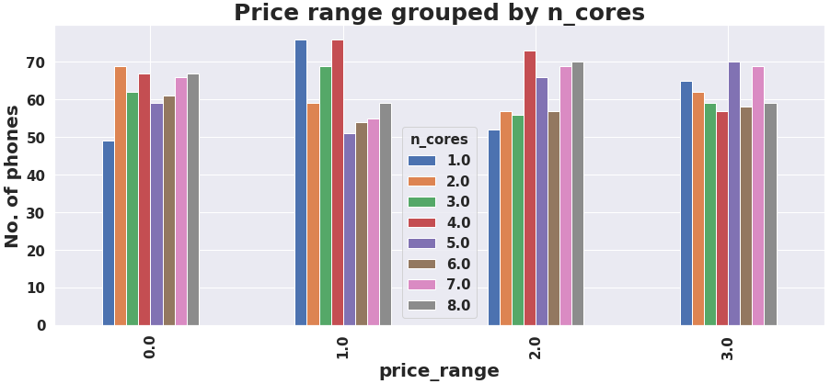
Bivariate and Multivariate Analysis
1] There are few mobiles in price range of 0 and 2 with lesser no of crores.
2] Most of mobiles in price range 2 and 3 are with high no of crores.
3]Number of phone with less thickness is high and count of phones with high thickness is low.

Slide 18
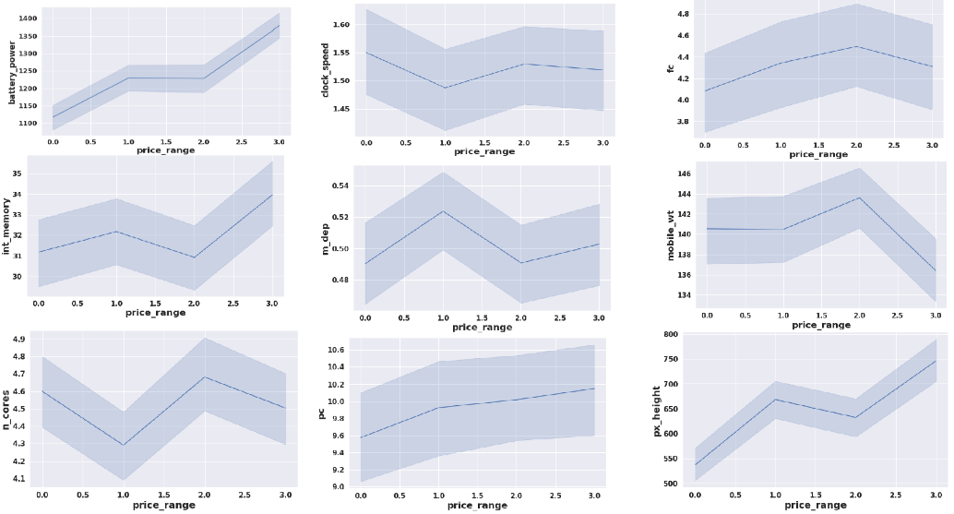
Bivariate and Multivariate Analysis
Different trends of price range v/s other features.

Slide 19
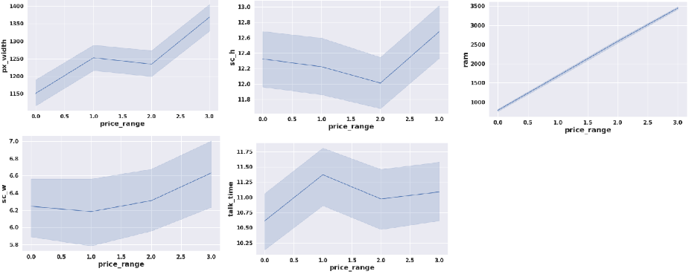
Bivariate and Multivariate Analysis
Different trends of price range v/s other features

Slide 20
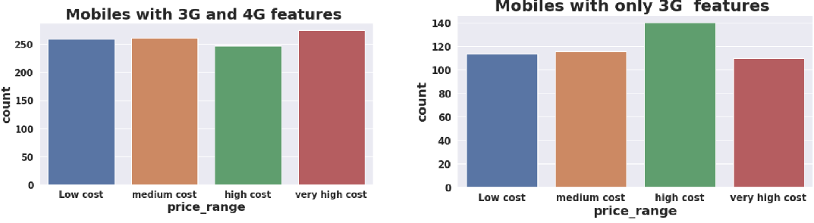
Exploratory Data Analysis
1]Bivariate and Multivariate Analysis
2] Count of mobiles with 3G and 4G is high in very high cost category.
3] Count of mobiles with only 3G feature is high in very high cost category.

Slide 21
Model Selection and Evaluation
1} Before building a models we performed the train test spilt. We kept 25% of the data for test and remaining 75% of data for training the model.
We compare 6 algorithms and evaluated them based on the overall accuracy score and the recall of the individual classes.
2} Accuracy is the ratio of the total number of correct predictions.
3} The recall is the measure of our model correctly identified True positives.
Decision Tree
Random Forest Classifier
Gradient Boosting Classifier
K-Nearest Neighbor Classifier
XG Boost Classifier
Support Vector Machine(SVM)

Slide 22
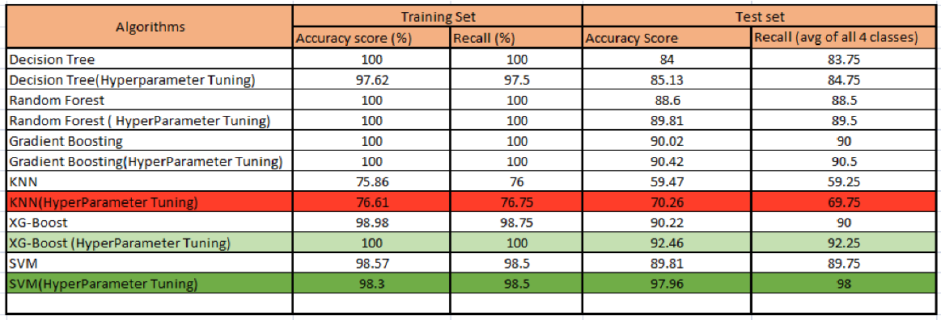
Evaluation of Models:
1} Best model came out to be SVM after hyperparameter tuning.
2} XG Boost (hyperparameter tuning) can be considered as the second most good model
3}KNN performed very worst.

Slide 23
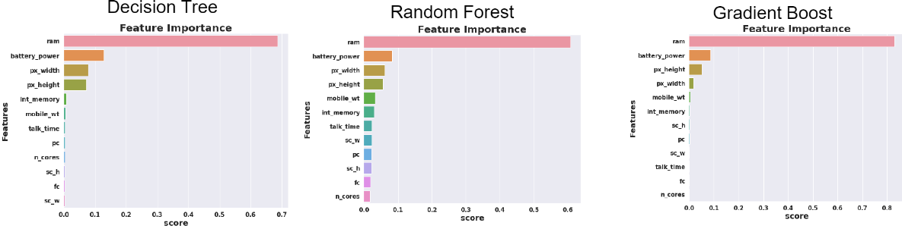
Features Important

Slide 24
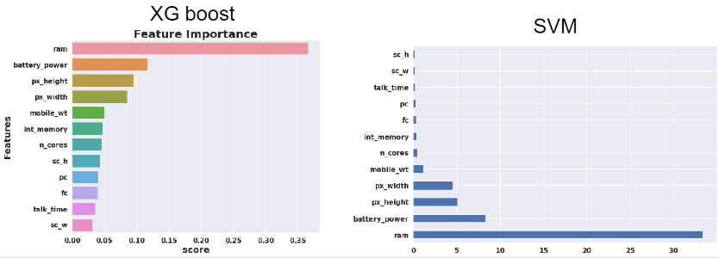
RAM , Battery power, Pixel height and weight contributed the most in predicting the price range.

Slide 25
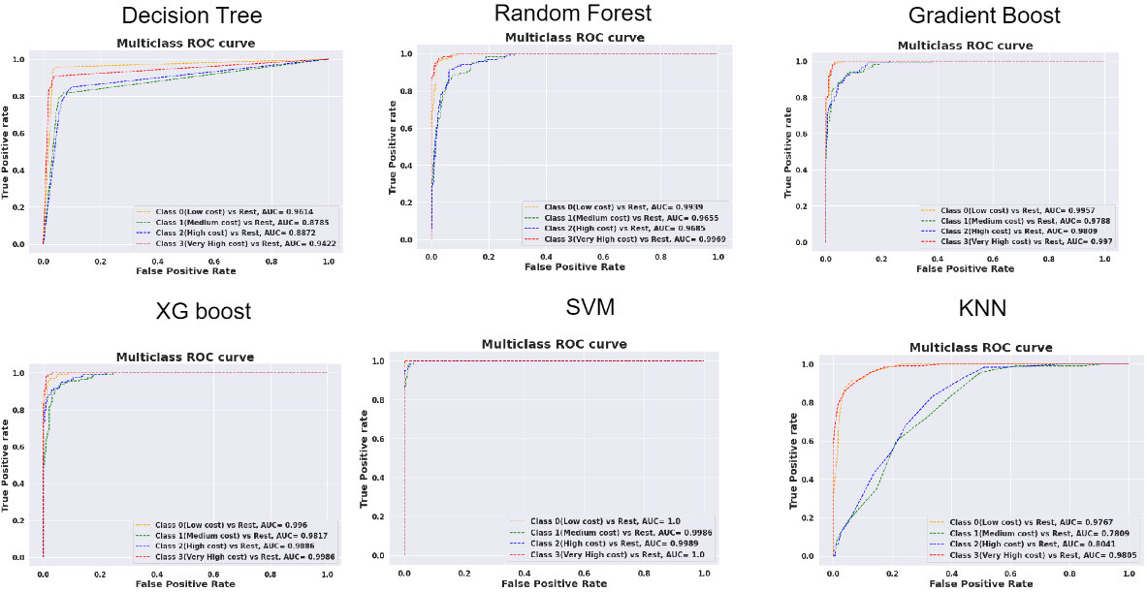
AUC ROC Curves

Slide 26
Conclusions
1] we started with data understanding, data wrangling, basic EDA where we found the relationships, trends between the price range and other independent variables.
2] We selected the best features for predictive modelling by using K best feature selection method using Chi square statistic.
3]Implemented various classification algorithms, out of which the SVM(support vector machine)algorithm gave the best performance after hyper-parameter tuning with 98.3% train accuracy and 97% train accuracy.
4] XGBoost is the second best good model which gave good performance after hyper-parameter tuning with 100% train accuracy and 92.25% test accuracy score.
5]KNN gave very worst model performance,
6]We checked for the features importance’s of each model. RAM , Battery power, px_height and px_weight contributed the most while predicting the price range.

Slide 27
THANKYOU

